Slide 1

Embroidery Strategy Overview

Slide 2
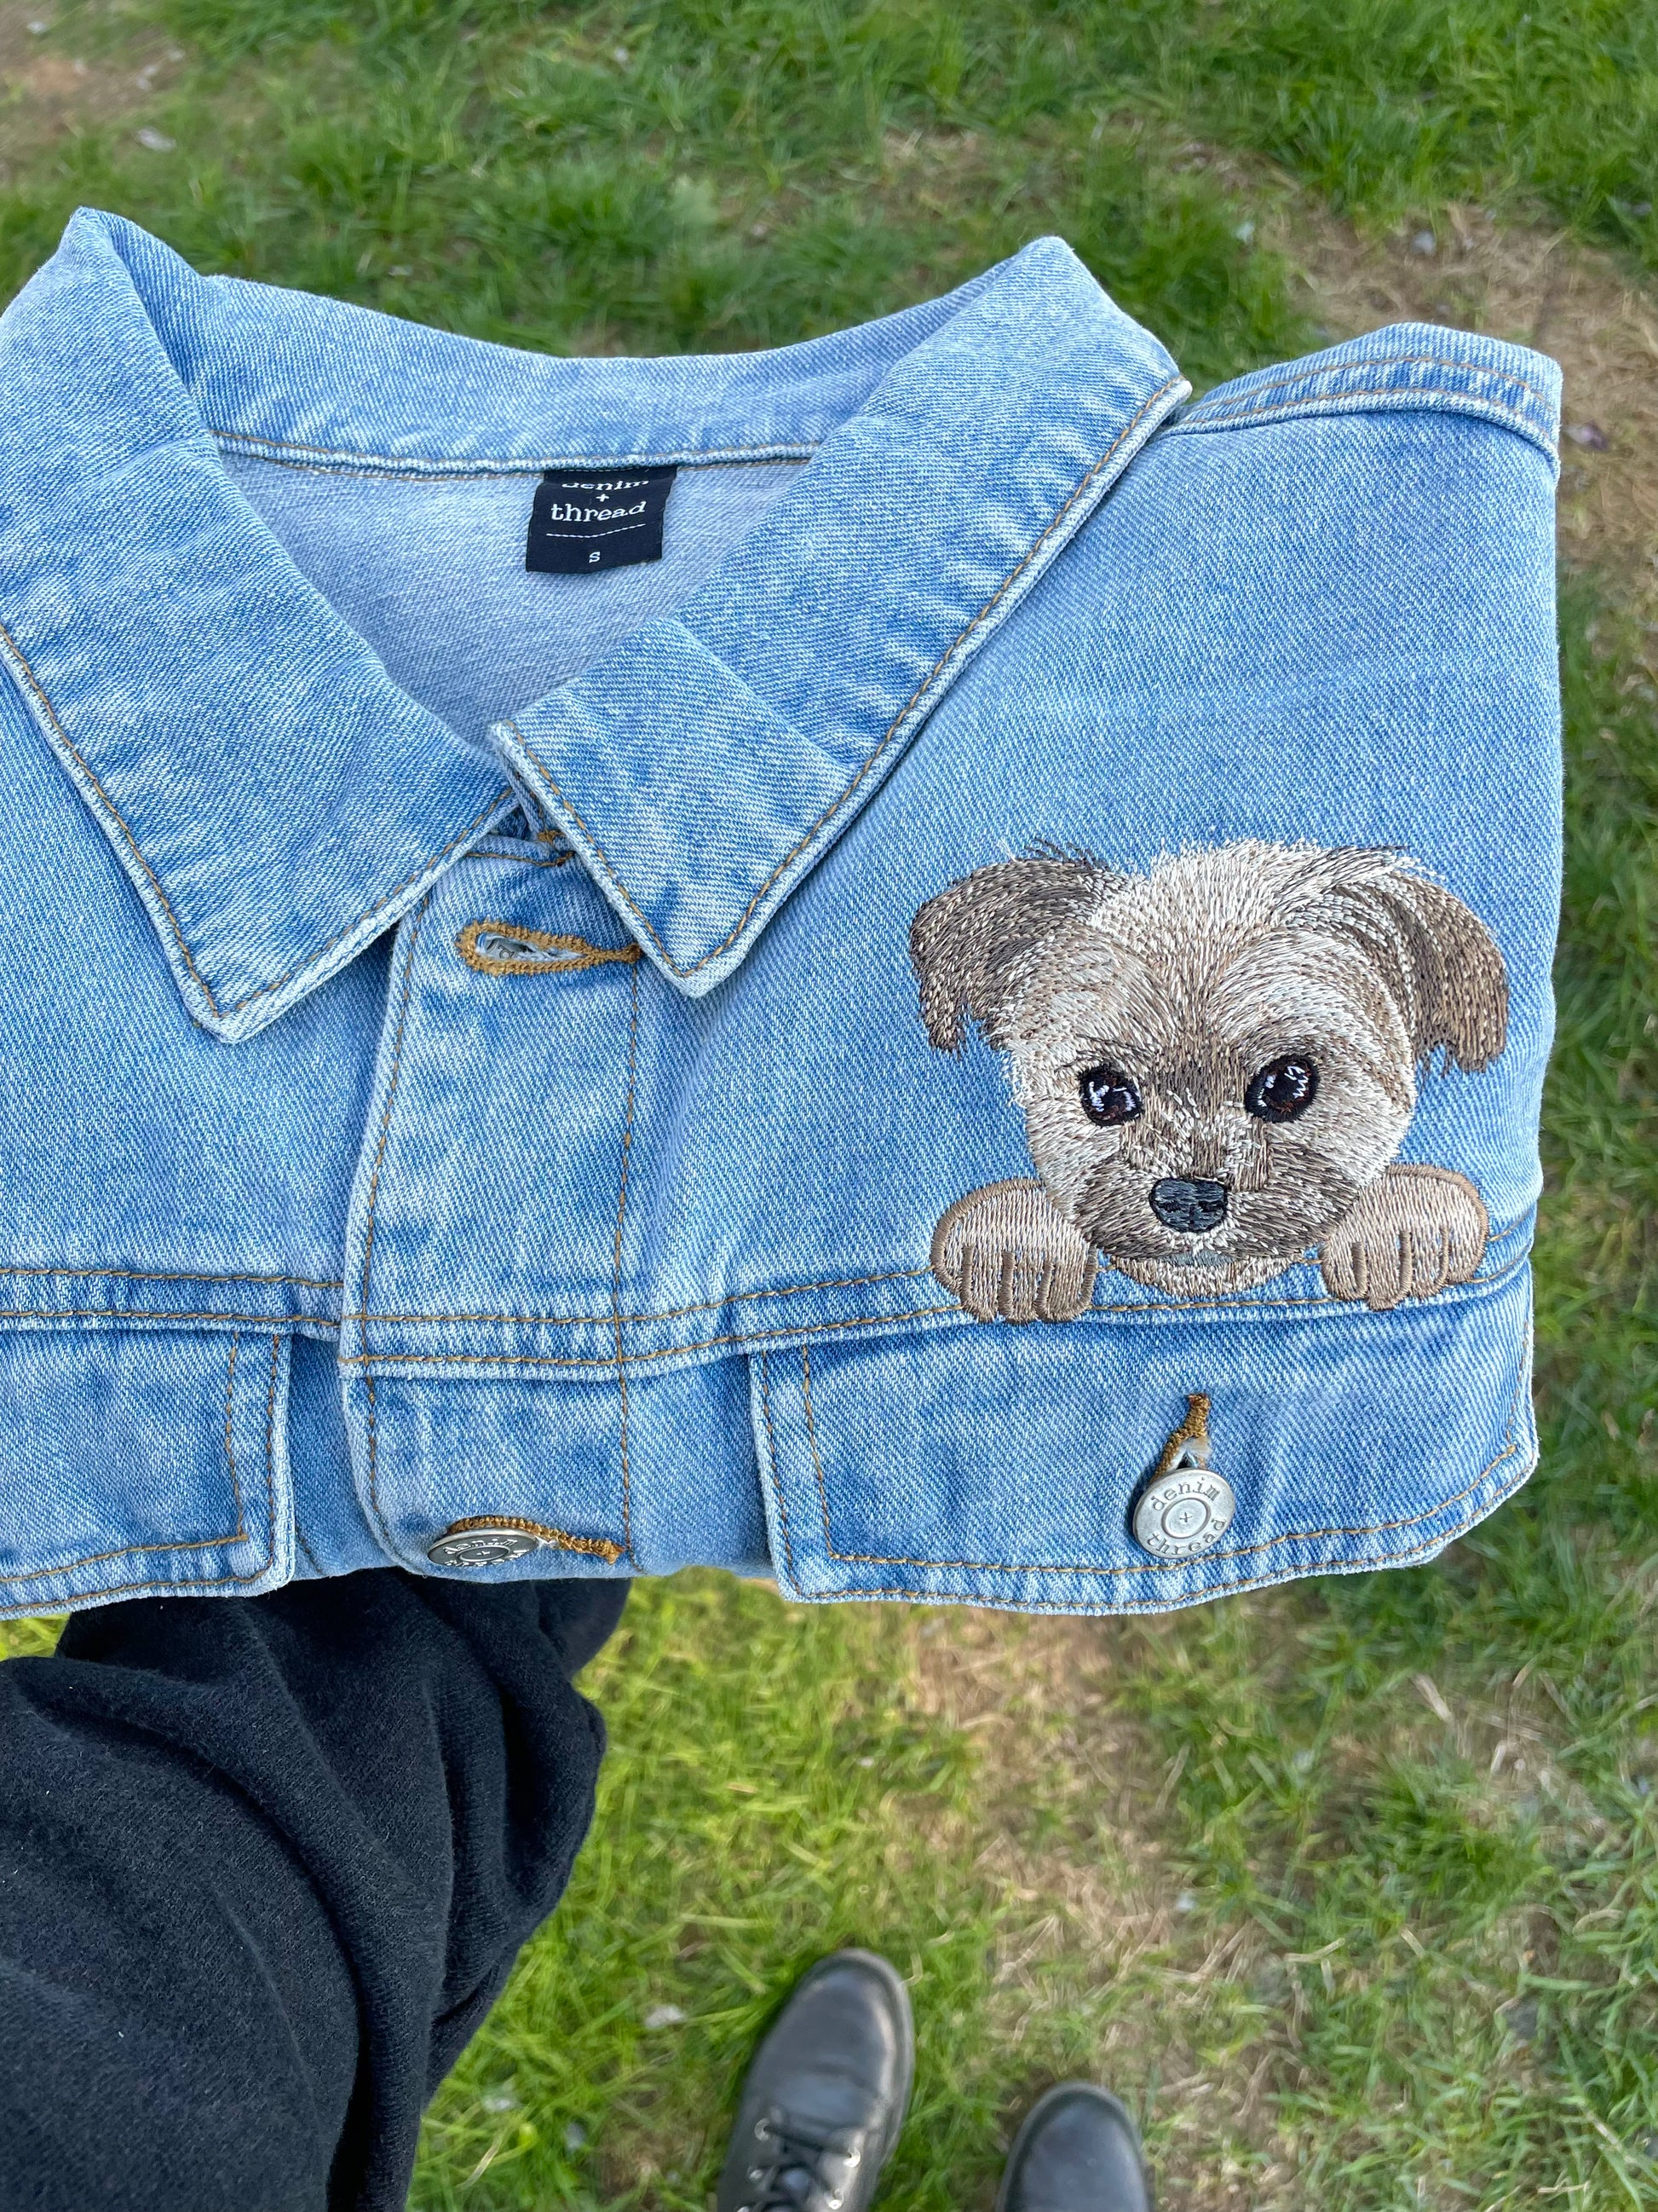

What is embroidery?
Embroidery machines allow users to personalize apparel, bags, quilts, and more to fit the personality of the recipient of the item. Garment personalization is a huge industry covering markets from pets to bridal wear. Embroidery machines allow users to customize items permanently and expand their creative options. A machine that allows you to both sew and embroider is called a “combination” machine. The size of the hoop indicates your embroidery area.

Slide 3
LAC Strategy
Objective
To successfully launch Brother’s embroidery machines in LAC by positioning them as the premium choice for precision, durability, and innovation while demonstrating their value beyond price.
Target Audience
Hobbyists & DIY Enthusiasts: Individuals who love embroidery as a creative outlet and want high-quality, easy-to-use machines.
Entrepreneurs & Small Business Owners: Those looking to turn their passion into a profitable business and need reliable, professional-grade embroidery machines.
Fashion Designers & Textile Artists: Professionals in the fashion and textile industries who require advanced embroidery technology for unique designs.
Sewing Enthusiasts Upgrading Their Skills/ Experienced crafters: Users who already sew and want to expand their capabilities into embroidery.
Key Value Propositions
Precision & Quality: Japanese-engineered technology ensures every stitch is perfect.
Ease of Use: Touchscreen controls, automatic thread cutting, and advanced design editing make embroidery accessible for all skill levels.
Business Growth Tool: High-speed embroidery and customization options help entrepreneurs scale their businesses.
Exclusive Features: Wi-Fi connectivity, built-in designs, and seamless integration with embroidery software (including actualizations).
Unmatched Support: Access to exclusive training, service, and warranty programs tailored for embroidery professionals.

Slide 4
Overview
Market Leader
Embroidery is the top revenue-generating product in the decorated apparel market across Latin America.
Growth Drivers
  Customization Trend – Rising demand for personalized clothing is driving increased embroidery usage.
  Fashion Trends – Embroidery is increasingly integrated into contemporary fashion designs.
Challenges
  Competition from Imports – Price pressure from low-cost embroidered products from other regions.
  Skilled Labor Shortage – Limited availability of experienced embroiderers in certain areas.
  Raw Material Costs – Price fluctuations in fabrics and threads.
Key Market Segments
  Apparel – The largest segment, with embroidery widely used on shirts, dresses, jeans, and more.
  Home Décor – Popular for tablecloths, pillowcases, and curtains.
  Accessories – Increasing demand for embroidered bags, hats, and belts.
Industry Overview:
The DIY & personalized fashion market is growing in LAC, with a rise in customized clothing, accessories, and home décor.
E-commerce and digital learning are accelerating the adoption of embroidery, as users can easily access training and supplies online.
Social media influence: Instagram, TikTok, and Pinterest drive the demand for unique embroidered products, especially for entrepreneurs selling on Etsy and similar platforms.
https://www.cognitivemarketresearch.com/

Slide 5
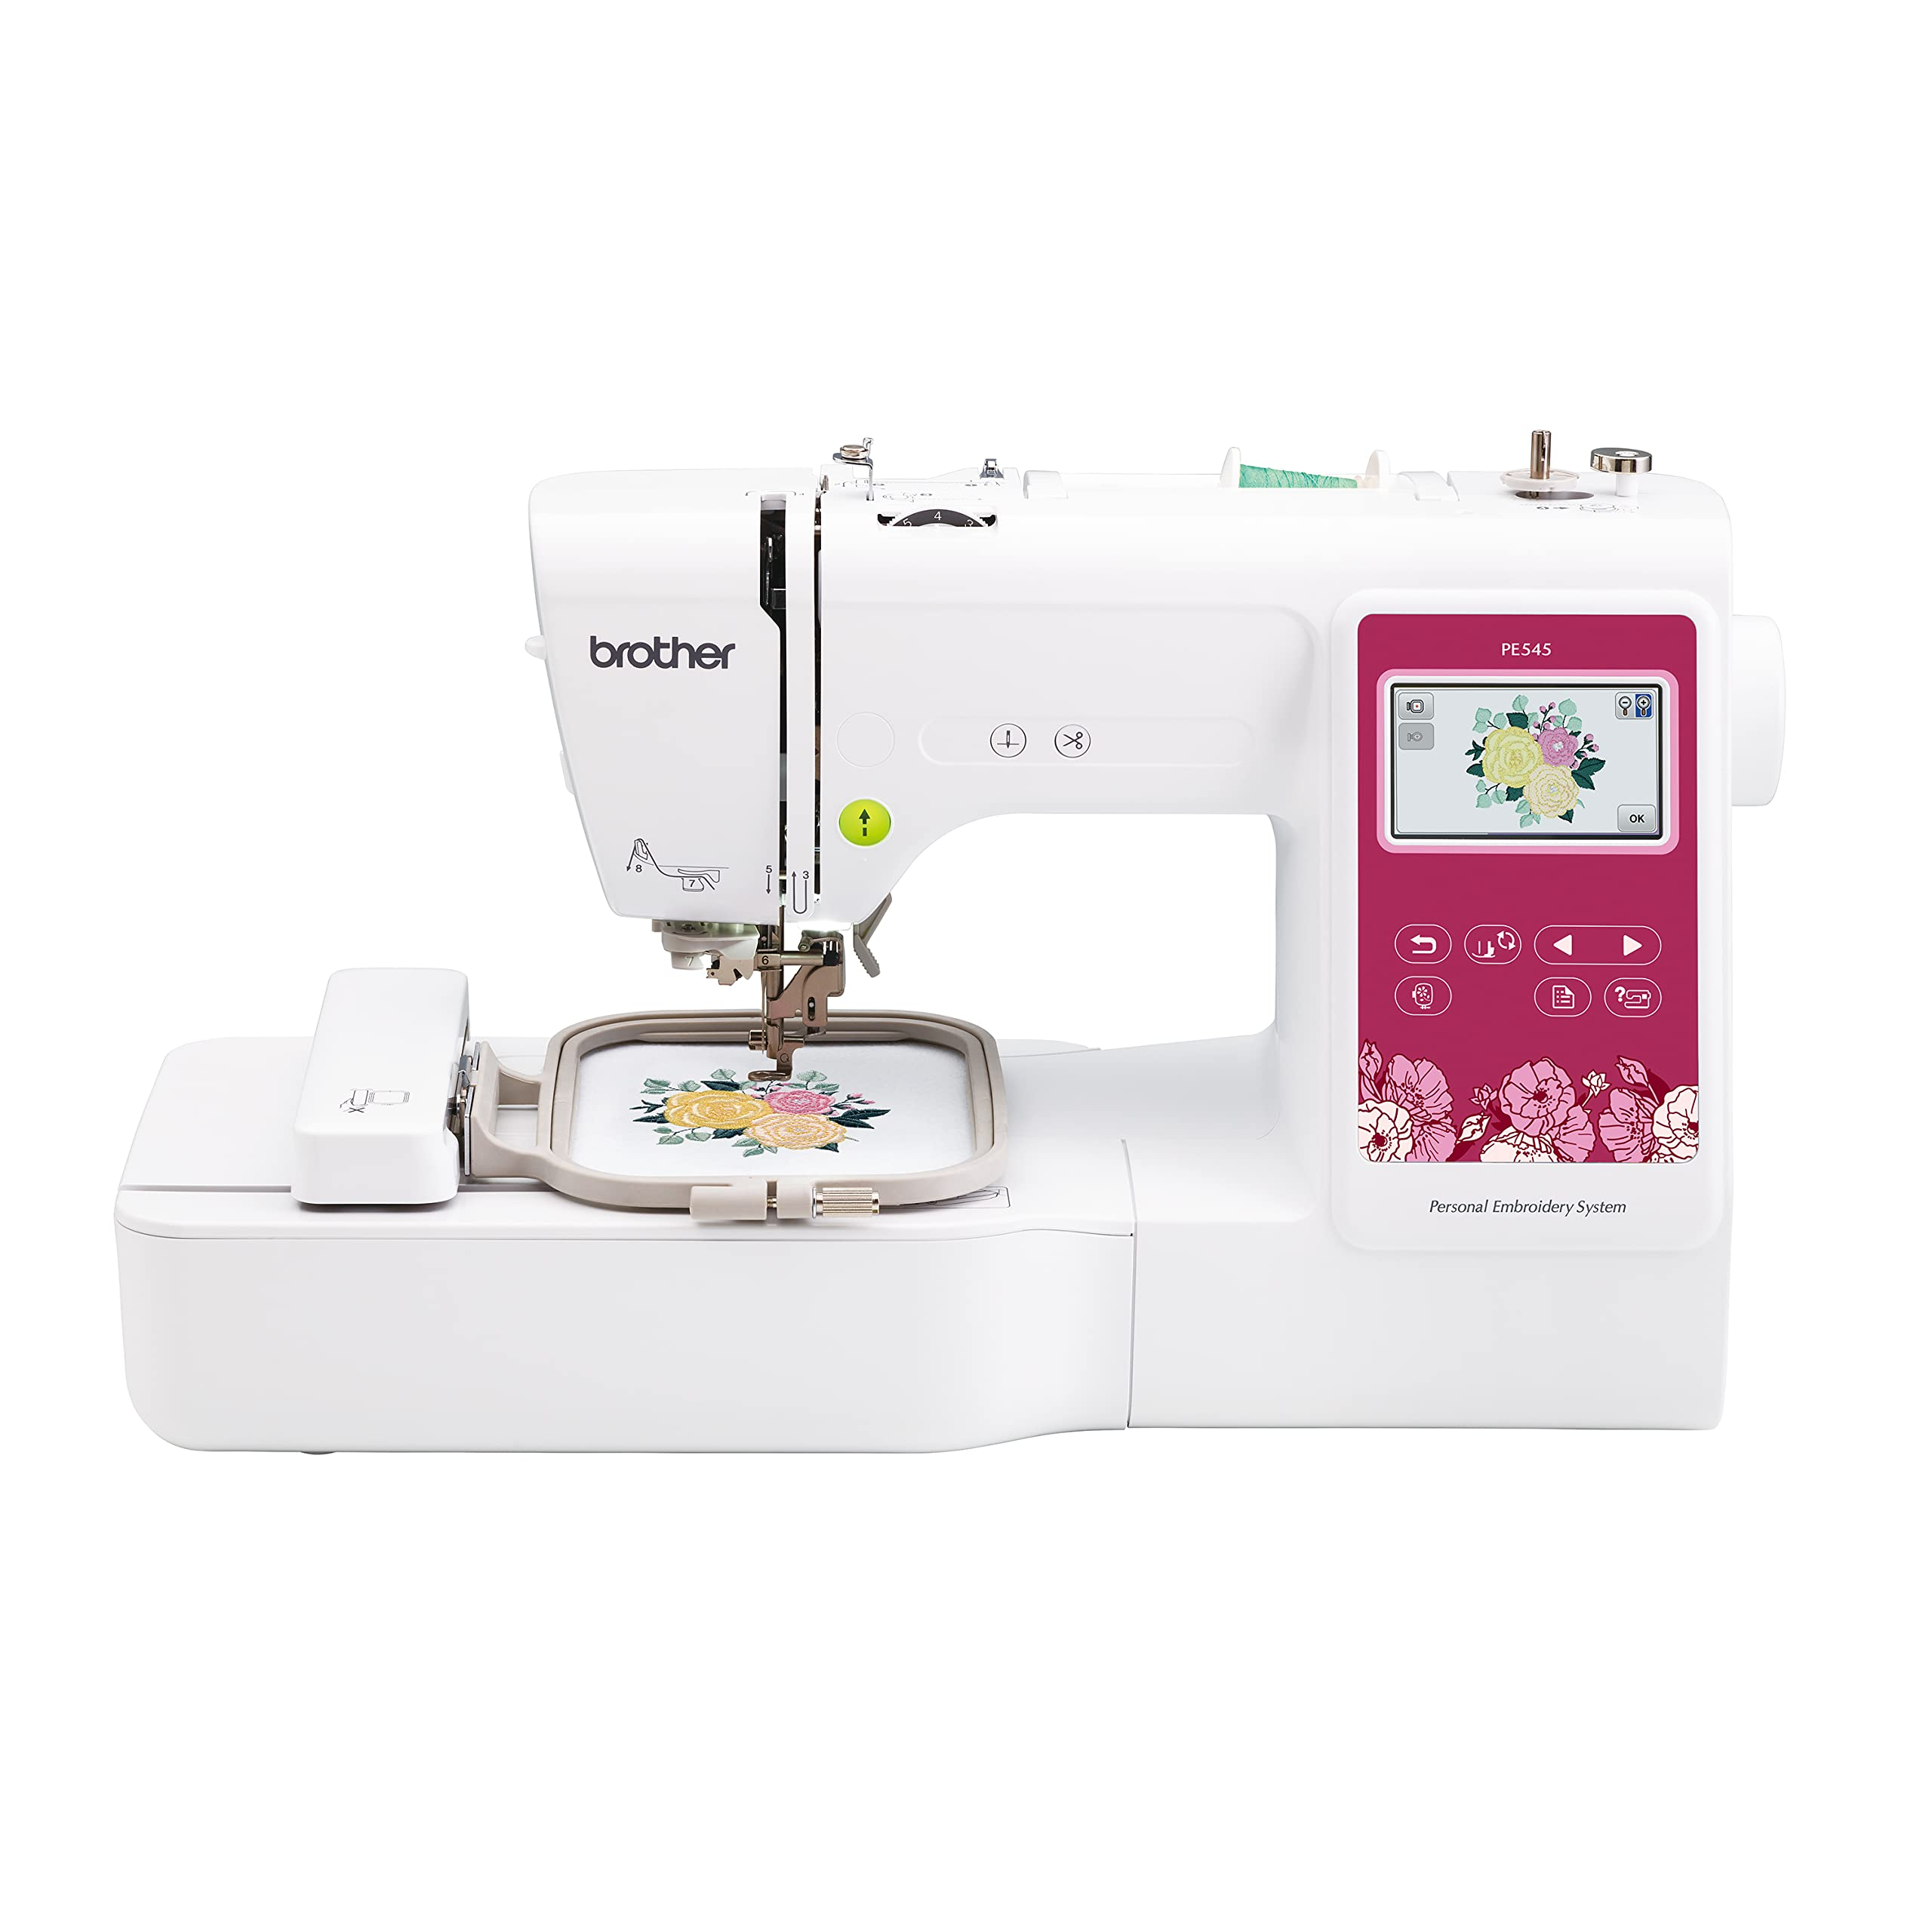
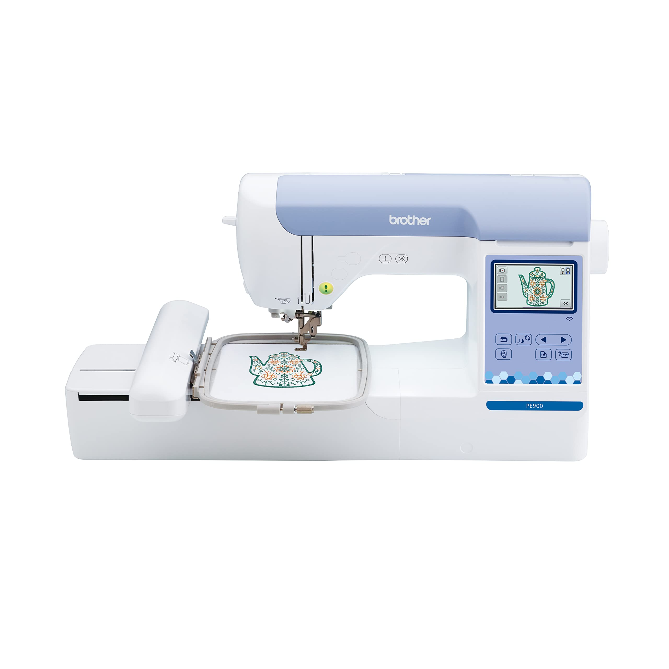
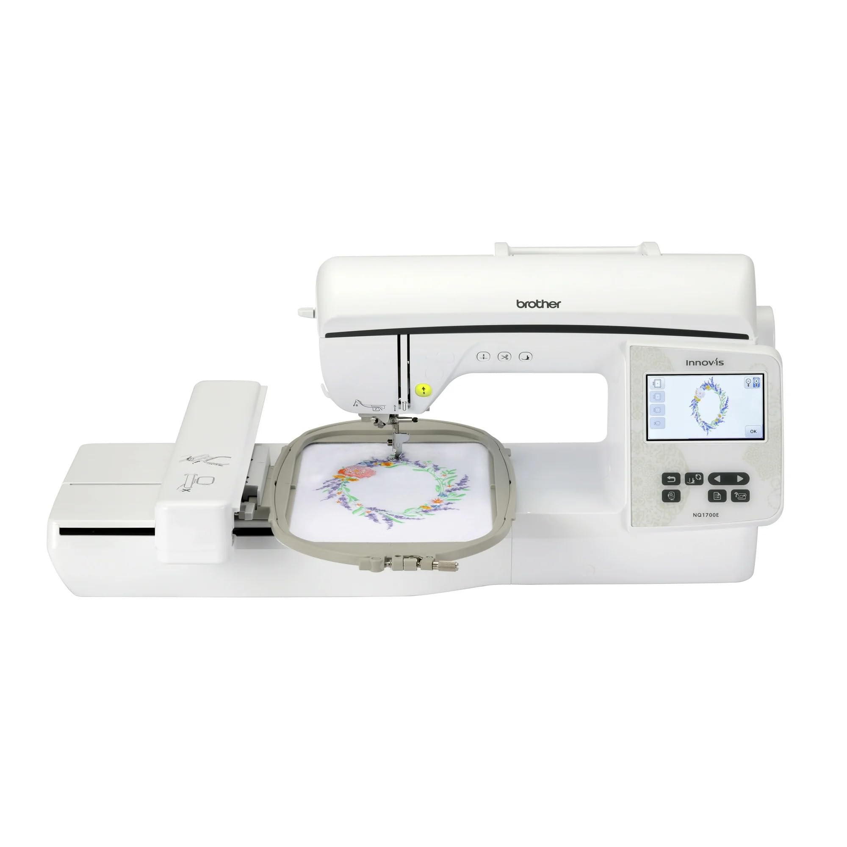
HEM Models
PE545
PE900
NQ1700E

Slide 6
Competitor Capabilities Analysis
Feature | PE545 | PE900 | NQ1700E | Present in Competitors?
Wi-Fi Connectivity | ✅ | ✅ | ✅ | ❌ (Janome and Singer only have USB)
Artspira App (allows editing and sending designs from a mobile device) | ✅ | ✅ | ✅ | ❌ (Janome and Singer do not have a similar app)
Built-in Embroidery Fonts | 10 | 13 | 13 | ❌ (Singer has none, Janome has fewer fonts)
Advanced Color Touchscreen | 3.7" | 3.7" | 4.85" | ❌ (Janome uses a standard LCD, Singer has a touchscreen but less intuitive)
On-Screen Embroidery Editing (modify, rotate, group, and resize designs without external software) | ✅ | ✅ | ✅ | ❌ (Singer and Janome have limited on-screen editing functions)
Jump Stitch Trimming (automatically trims threads when jumping between areas) | ❌ | ✅ | ✅ | ❌ (Janome options require manual intervention in some models)
USB Port for Importing Designs | ✅ | ✅ | ✅ | ✅ (Also available in Singer and Janome)
Automatic Stitch Density Adjustment | ✅ | ✅ | ✅ | ❌ (Singer and Janome mostly require manual adjustments)
Brother machines offer Wi-Fi connectivity and compatibility with the Artspira app, allowing users to send designs from their phones without the need for cables or complex software. They also have more built-in embroidery fonts, more intuitive touchscreens, and advanced tools like Jump Stitch Trimming, which automates thread cutting.
While Janome and Singer may offer larger embroidery areas, Brother machines stand out for their ease of use, connectivity, and smart features, making them ideal for users looking for efficiency and technology in their embroidery projects.

Slide 7
Competitor Specifications Analysis
Feature | PE545 | PE900 | Innov-is NQ1700E | Janome Memory Craft 400E | Janome Memory Craft 500E | Singer Quantum Stylist EM200
Maximum Embroidery Area | 4" x 4" | 5" x 7" | 6" x 10" | 7.9" x 7.9" | 7.9" x 11" | 10.25" x 6"
Built-in Embroidery Designs | 135 | 193 | 258 | 160 | 160 | 200
Built-in Embroidery Fonts | 10 | 13 | 13 | 6 | 6 | 0
Maximum Embroidery Speed | 400 SPM | 650 SPM | 850 SPM | 860 SPM | 860 SPM | 700 SPM
Color Touchscreen | Yes, 3.7" | Yes | Yes, 4.85" | Yes | Yes, LCD | Yes
Connectivity | Wireless LAN & USB | Wi-Fi & USB | Wireless LAN & USB | USB | USB | USB
Brother's embroidery machines stand out for their user-friendly interfaces, Wi-Fi connectivity, and comprehensive design options. While Janome and Singer offer machines with larger embroidery areas, they often lack the connectivity features and user-centric designs found in Brother models.

Slide 8
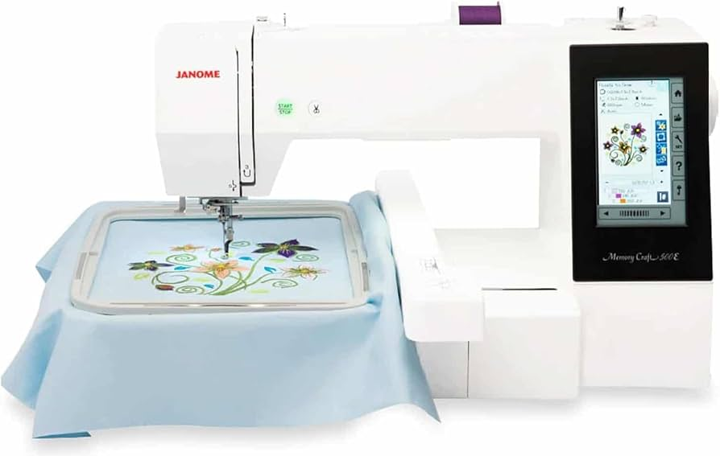
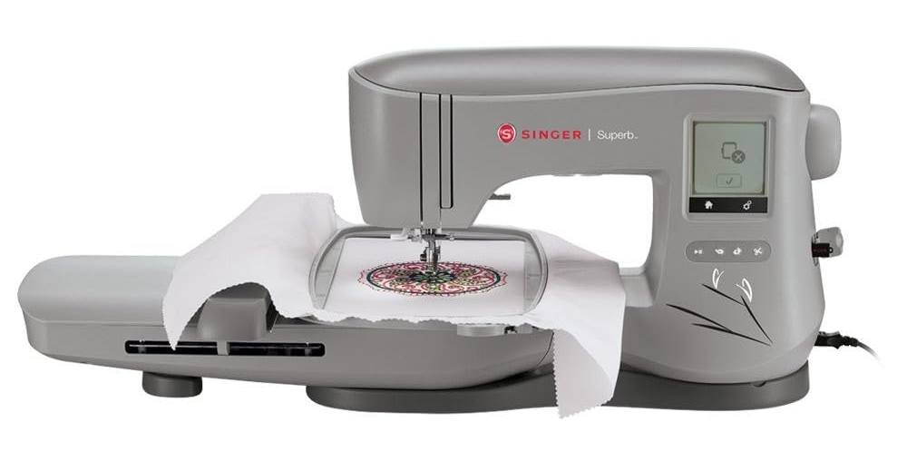
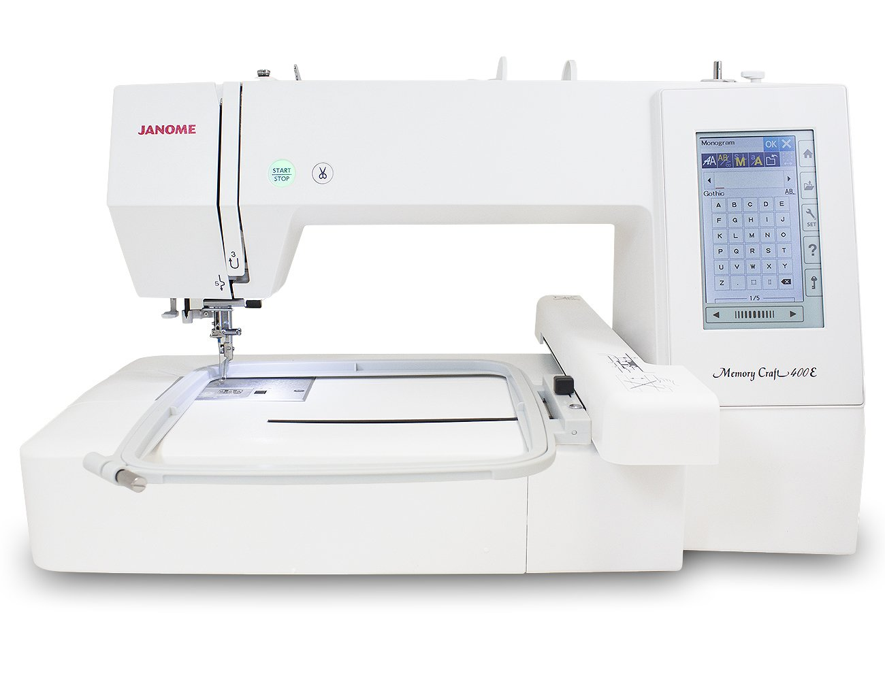
Competitor Pricing Analysis
BROTHER
Janome
Singer
NQ1700E
$2.1K
MC500E
$2K
$2K
EM200
$1.7K
PE900
$1800
$1.5K
MC400E
$1.5K
$1K
PE545
$900
$0K

Slide 9
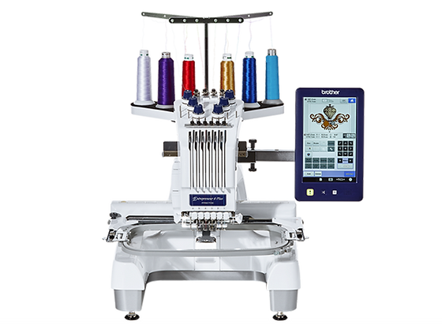
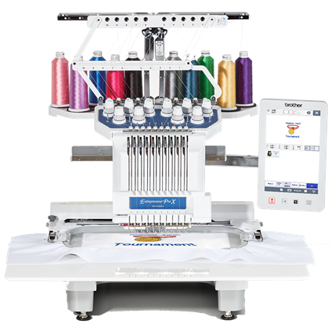
PR Models
PR680W
PR1060W

Slide 10
Subsidiary Metrics Eval
Data | Product | Argentina | Brazil | Chile | Mexico | Peru
Sales | PRS100 | 23 | 16 | 30 | 22 | 5
 | PR680W | 34 | 338 |  | 101
 | PR1055x | 7 |  |  | 50
Price | PRS100 | $4.5K | $4K | $3.7K | $4.8K | $3.5K
 | PR680W | $9K | $6.5K | $5.8K | $7K | $5K
 | PR1055x | $13K | $7.5K | $7.5K | $10K | $6K

Slide 11
4P Analysis
Price
Price competitiveness
Product
PR Series ranging from 1 to 10 needles
Place
Dealers
Promotion
Landing page
Expos

Slide 12
SWOT
Strengths
Brother quality
Track Record
Package
Software (Artspira)
Weakness
Technical Support
Price competitiveness
Opportunities
Enhance our technical support
Partner with expert dealers
Target specific audiences (school providers, event planners, coorporations)
Threat
Competitors pricing
Local brands (OEM)

Slide 13
Competitor Capabilities Analysis
PR680W – PR1055X | Ricoma EM 1010 | Happy HCH-701 | Tajima Sai
Extensive Built-in Designs and Fonts Clear Thumbnail View Automatic Needle Threader Tool-Free Frame Holder Removal Effortless Frame Attachment & Removal Automatic Frame Selection & Embroidery Area Display Enhanced Safety with Frame Sensor Advanced On-Machine Editing Precise Positioning System Versatile Frame Options | Embroidery Area Display by Frame Selection Includes Special Stand Includes Cap Frame Effortless Frame Attachment & Removal Consistent Speed on Satin Stitch | Tool-Free Frame Holder Attachment Memory Function for Color Allocation Embroidery on Large Items Without a Front Base | Reduced Noise in Frame Movement (X, Y Axis) Narrow Cylinder Arm Consistent Speed on Satin Stitch High-Quality Embroidery at High Speeds
Speed Reduction on Satin Stitch | User-Defined Needle Color Allocation No Pre-Installed Designs Low-Quality Fonts No Safety Device for Embroidery Area Overrun Difficult Needle Threading | Large Space Requirement Due to Extended Body Depth Challenging Needle Attachment User-Defined Needle Color Allocation Speed Reduction on Satin Stitch | Difficult to Understand Upper Threading Challenging Needle Threading No Pre-Installed Designs Limited Editing Functions User-Defined Needle Color Allocation Difficult Frame Attachment & Removal Frame Origin Position Must Be Reset After Selection Change Mandatory Embroidery Area Tracing

Slide 14
Competitor Specifications Analysis
Specifications | PRS100 | PR680W | PR1055X | Ricoma EM1010 | Happy HCH-701 | Tajima SAI
Needles | 1 | 6 | 10 | 10 | 7 | 8
Max. Emb area | 8 x 8" | 12 x 8" | 14"x18" | 12.2 x 8.3" | 11.4 x 11.2" | 12 x 8"
Max. Speed (SPM) | 1,000 | 1,000 | 1000 | 1000 | 1000 | 800
Built in fonts | 20 | 50 | 37 | 10 | 12 | 8
Built in designs | 469 | 989 | 1184 | 1 | 100 | 2
Panel | 7" | 10.1" | 10.1" | 7" | 7"
LCD Type | Color LCD with touch screen | Color LCD with touch screen | Color LCD with touch screen | Color LCD with touch screen | Color LCD with touch screen | Color LCD with touch screen
Thread Sensor | Bobbin/Upper Thread | Bobbin/Upper Thread | Bobbin/Upper Thread | Bobbin/Upper Thread | Bobbin/Upper Thread | Bobbin/Upper Thread
Threading System | Auto | Auto | Auto | Manual | Manual | Manual
Auto Thread Cutting | Yes | Yes | Yes | Yes | Yes
Included Frames | 6 | 4 | 4 | 5 | 2 | 2
Optional Frames |  |  | 20 | 0 | 8 | 1
Magnetic Frames | No | Yes | Yes | No | No | No
Frame Detection |  | Yes | Yes | No | No | No
Live Camera Positioning | No | No | Yes | No | No | No
Quilting | No | Yes | Yes | No | No | No
Stand Included | No | No | No | Yes | No | No
Price | $3.8K | $5.9K | $7.2K | $6.7K | $6.1K | $7.5K
Software | No | Yes | Yes | No | Yes - limited | Yes - limited

Slide 15
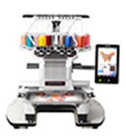
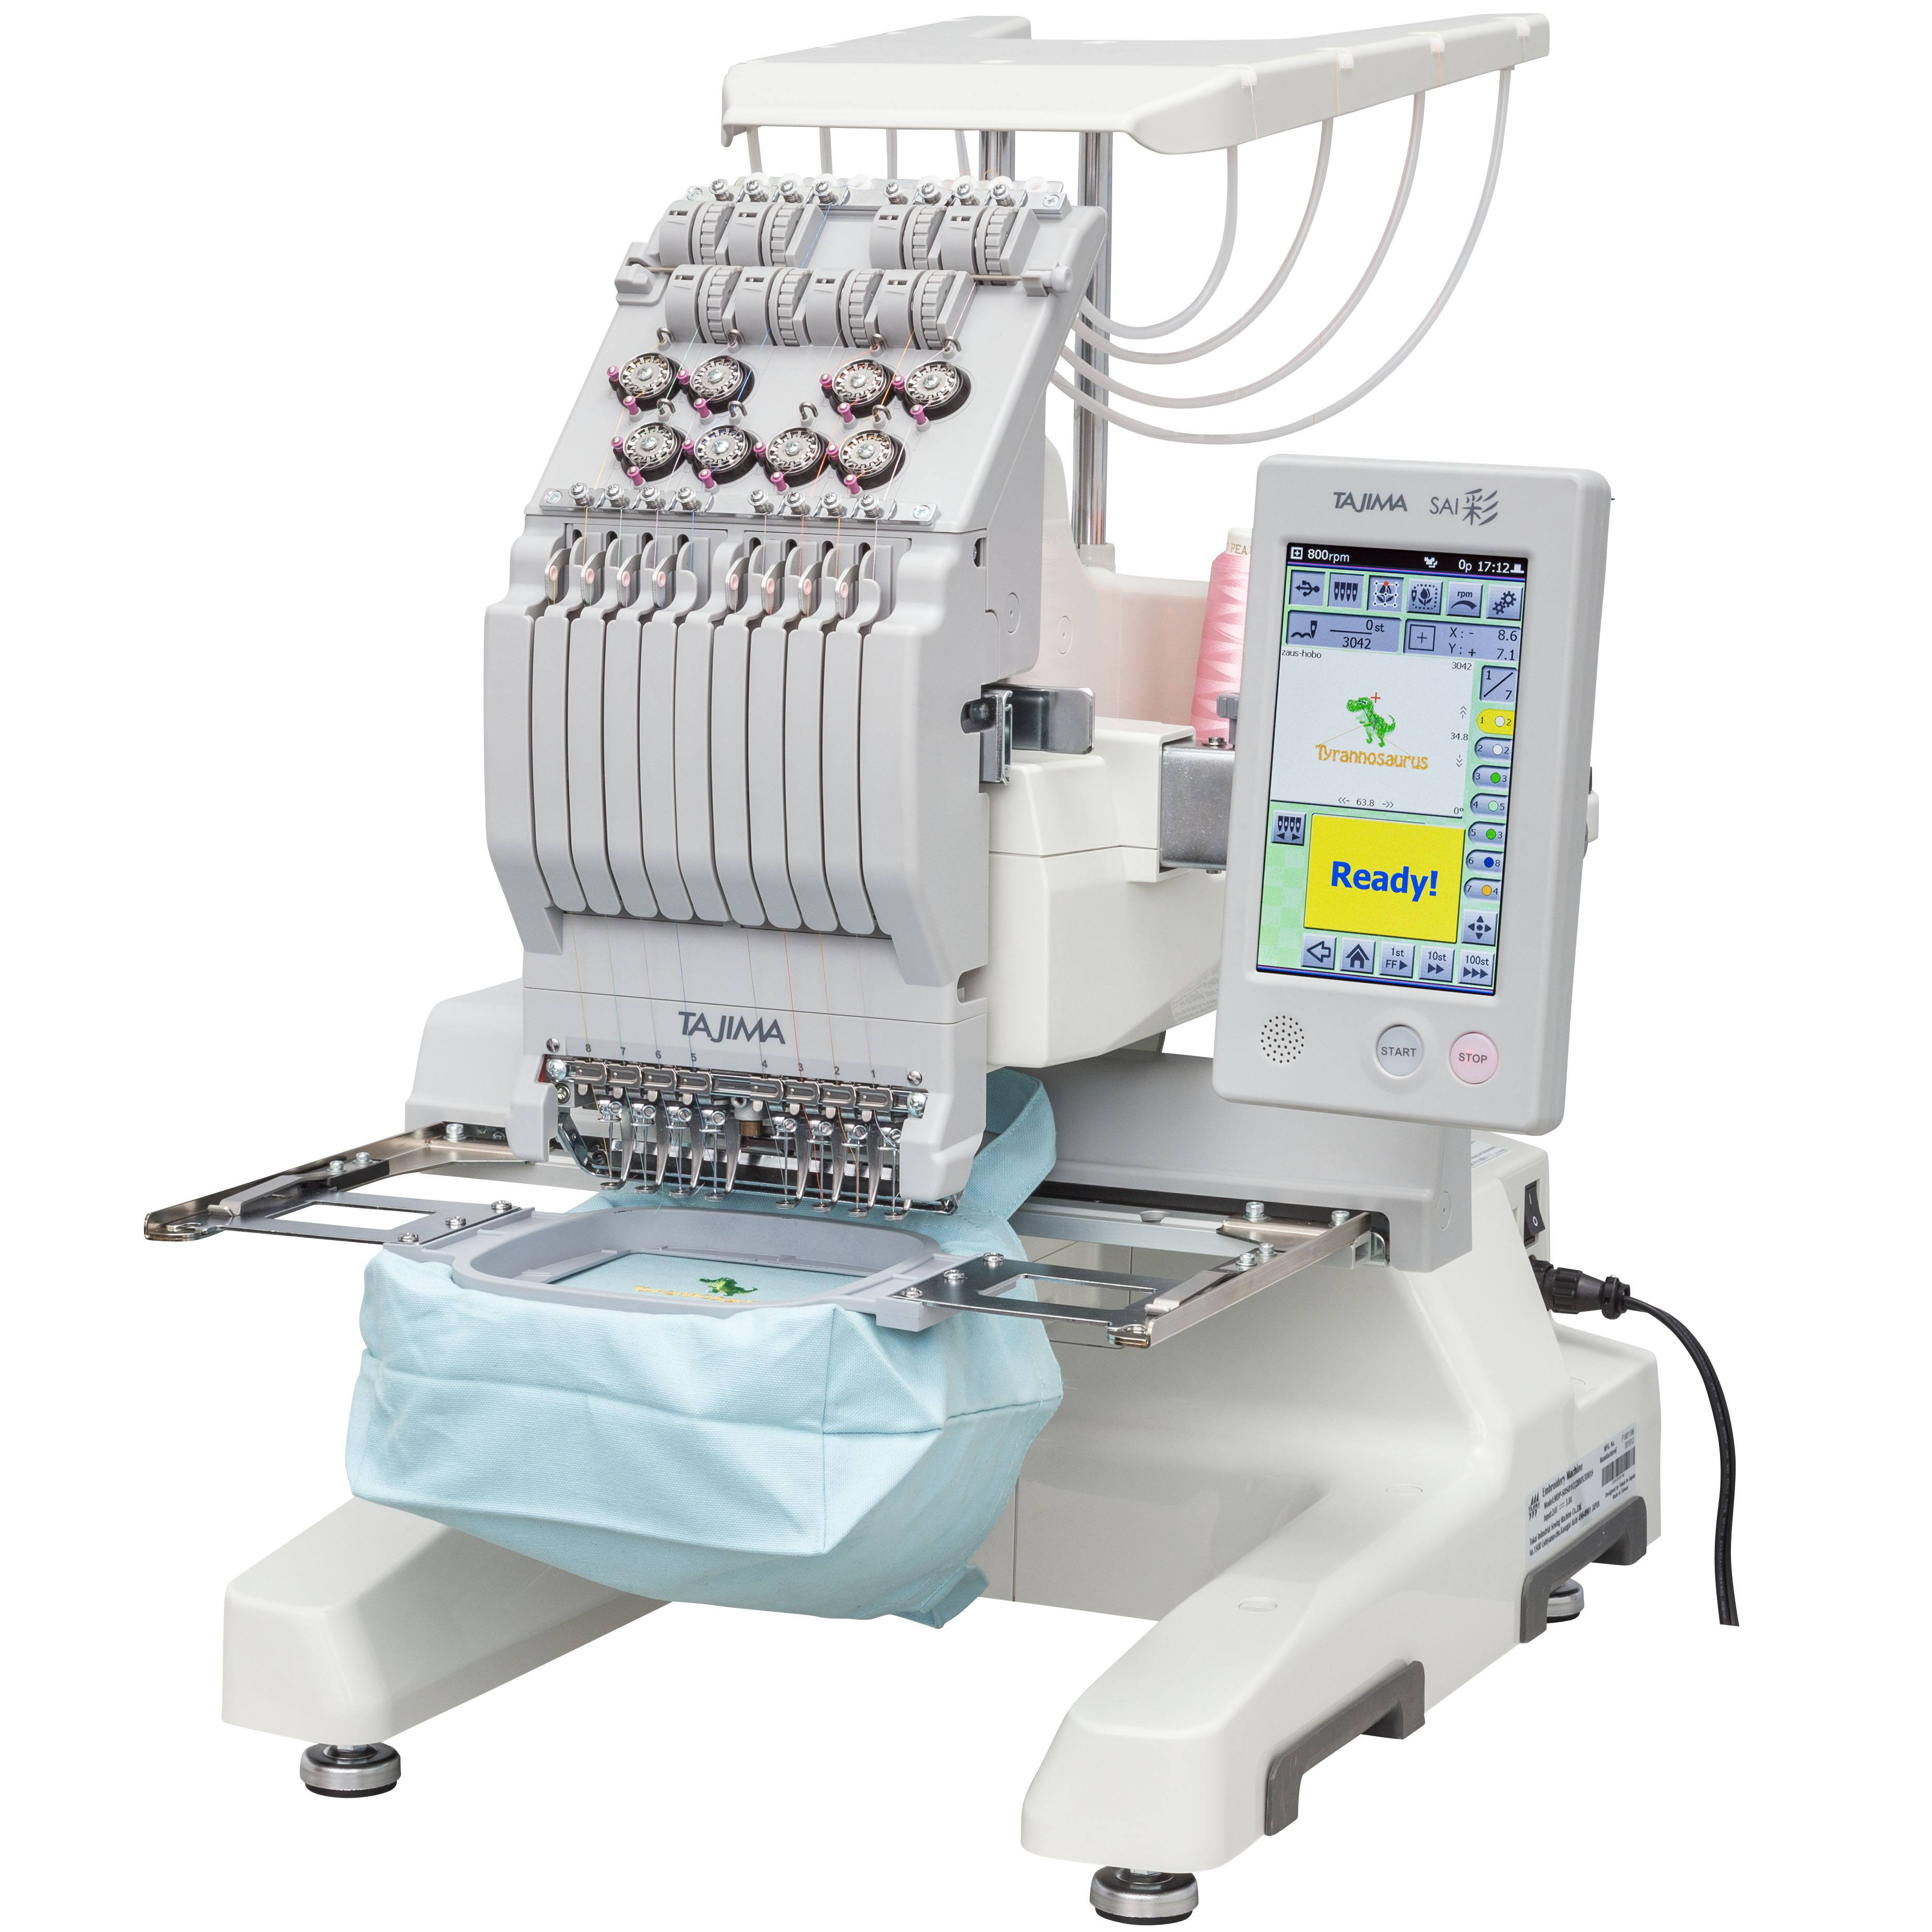
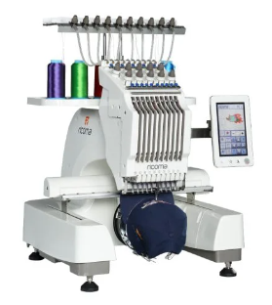
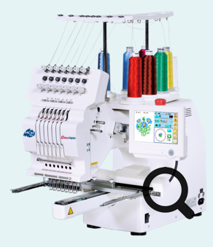
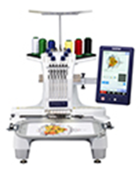
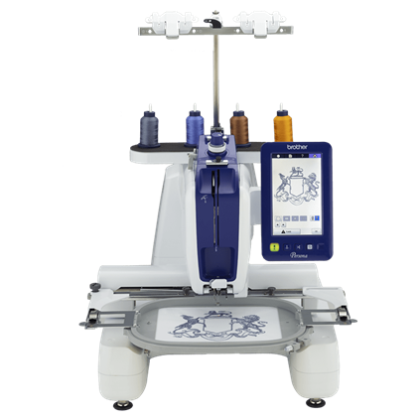
Competitor Pricing Analysis
BROTHER
RICOMA
Happy HCH- 701
Tajima SAI
$9K
PR1055X
Tajima Sai
$7.5K
$7K
EM 1010
$6.7K
HCH-701P
$6.1K
PR680W
$5K
PRS100
$3K

Slide 16
Demand Generation
Dealer Outreach
05
04
Measure and Optimize: Track performance and continuously refine strategies
03
Engage Across Channels: Use a multichannel approach to reach target accounts
02
Create Personalized Content: Develop tailored content and messaging.
01
Research and Insights: Deep dive into account-specific data to understand needs and pain points
Identify Target Accounts: Use data and insights to select high-value accounts.
Step A
Step B
Step C
Step D
Step E

Slide 17
Demand Generation
Dealer Outreach
Top 4 Countries
  Colombia
  Guatemala
  Panama
  Costa Rica
Meta & Google Ads tailored to specific audiences
  Distributors of Industrial and Semi-Industrial Sewing Equipment
  Wholesalers in the Textile Industry Commercial Embroidery Businesses Looking to Expand
  Suppliers for Custom Apparel and Promotional Products
Landing Page
  Header – Partnership with Brother
  Form – Contact information
  Brother Distributor Advantages
    High ROI
    Quality Product offering
    Training
    Marketing

Slide 18
End User Profiling – Vertical Expansion Opportunities
The semi‑industrial PR Series (PR680W & PR1060W) is positioned to serve a wide range of end‑user profiles that value personalization, on‑demand production, and professional-quality embroidery without the footprint of industrial machines. Understanding these end users helps us define clear vertical opportunities that will accelerate adoption and maximize sell‑out across the region.
Vertical | End User Profile | Why It Matters | Brother Advantage
Apparel & Accessories | Retail chains, boutiques, uniform shops | Personalization increases basket size, differentiates retail | High quality, fast, compact, easy to train
Corporate Merchandising | Promo agencies, merch shops, branding firms | Small-batch corporate orders growing | Multi-color capability, uptime, pro finish
Education | Technical schools, design programs | Builds future user base; stable budgets | Easy to use, durable, classroom compatible
Quick-Turn Kiosks | Mall kiosks, pop-ups, event booths | High-margin, fast-turn personalization | Compact, fast, quiet, portable

Slide 19
Timeline and Financial Analysis
 | Timing | Key Milestones
0. Pre-Launch | Feb–Mar 2026 | Alignment, pricing, legal, materials, bundles
1. Market Prep | Mar–Apr 2026 | Dealer selection, logistics, training content
2. Launch | April 2026 | Dealer onboarding, demo installation, kickoff
3. Activation | May–Jun 2026 | Vertical campaigns, demos, fairs, pipeline
4. Monitoring | May–Jul 2026 | Dealer reports, compliance, conversion tracking
5. Phase 2 Rollout | May–Jun 2026 | CR/SV/DR/HN/PA onboarding and pipeline
6. Consolidation | Oct+ | Rest of the Markets
Metric | Value
Total Demo Investment (10 PR680W) | $0
Marketing and Events | $25,000
Full Program Revenue Sell Out (50 units) | $315,000
Full Program ROI (Marketing Investment) | 7.9%

Slide 20
Demand Generation
Customer Lead Generation
Meta & Google Ads tailored to specific audiences
  Small Business Owners
  Creative Professionals
  Educational Institutions
  Corporate Entities - uniform providers - hospitality industry
  Hobbyists and Enthusiasts
  Retail Businesses
  Event and Wedding Planners
  Distributors and Wholesalers
  Textile Manufacturers
Routed to Sales Leads
Lead
Dealer
Sales Rep
Ad
Notes:
Small Business Owners
Creative Professionals
Educational Institutions
Corporate Entities - uniform providers - hospitality industry
Hobbyists and Enthusiasts
Retail Businesses
Event and Wedding Planners
Distributors and Wholesalers
Textile Manufacturers

Slide 21
Demand Generation
Customer Landing Page Structure
Header
Call to Action
Form
Why Brother
Training
Warranty
Track Record
Magnetic Hoops
Software
Quality
Package
Reviews
Support
Warranty
Other businesses and customers reviews
Support page
Detailed warranty disclosure
Autothreading | Quilting Capable |14 x 8 embroidery area

Slide 22
Thank You

